Slide 1


Notes:
Design Choices :
I chose this theme because its minimalist design and soft color palette mirror the 'gentle' and 'laid-back' nature of the soft-pop genre.
I have used the slide master to automate a footer across the declk
Photo Credits : Google

Slide 2

THE EVOLUTION OF :
SOFT-POP
Notes:
Design Choices:
I used a high-quality full-bleed image here to immediately establish consistency.
I have configured this deck as a 'self-running' presentation by recording slide timings and narration. The 'Advance Slide' settings have been toggled to 'After' rather than 'On Mouse Click' to ensure the presentation can run unattended for a remote viewer
Photo Credits : Google

Slide 3
Overview
How is it characterized
Noteable Artists
Emerging Artists
Modern-Day Audience
Notes:
Design Choices:
I utilized a standard bulleted list for this slide
Photo Credits : Google

Slide 4
What is Soft-Pop ?
a subgenre of pop music characterized by gentle, melodic, and laid-back tunes, focusing on smooth vocals and accessible songwriting.
Notes:
Design Choices:
I modified the layout of this slide as way to create a a visual "break" in the presentation.
Photo Credits : Google

Slide 5
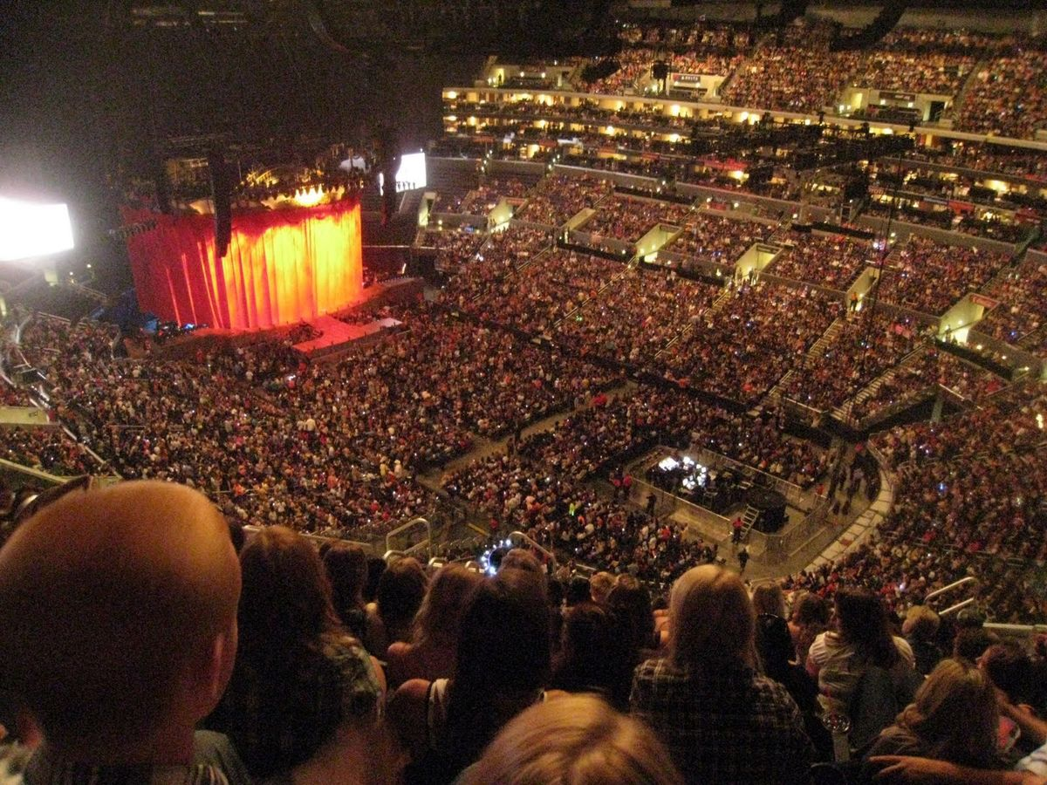
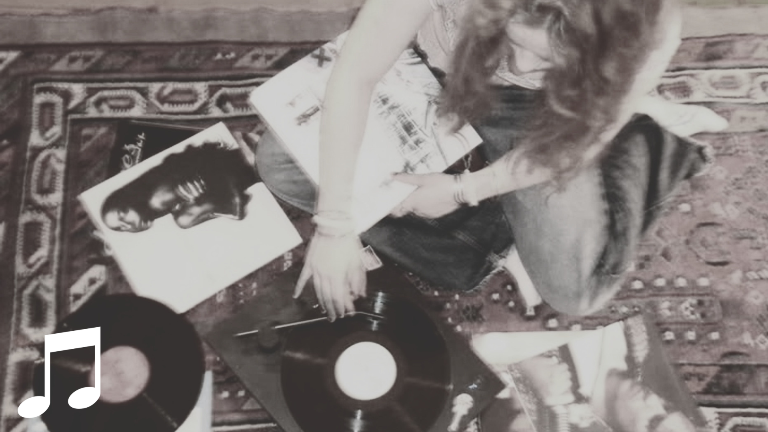
To selling out arenas
FROM A GENRE OF MUSIC MAINLY
LISTENED TO IN THE COMFORT OF ONE’S ROOM…..
Notes:
Design Choices:
I used "Entrance" effects for the bedroom image and "Exit" effects followed by a secondary entrance for the arena image. This visual "swap" reinforces the narrative of the genre’s growth without cluttering the layout.
Photo Credits : Google

Slide 6
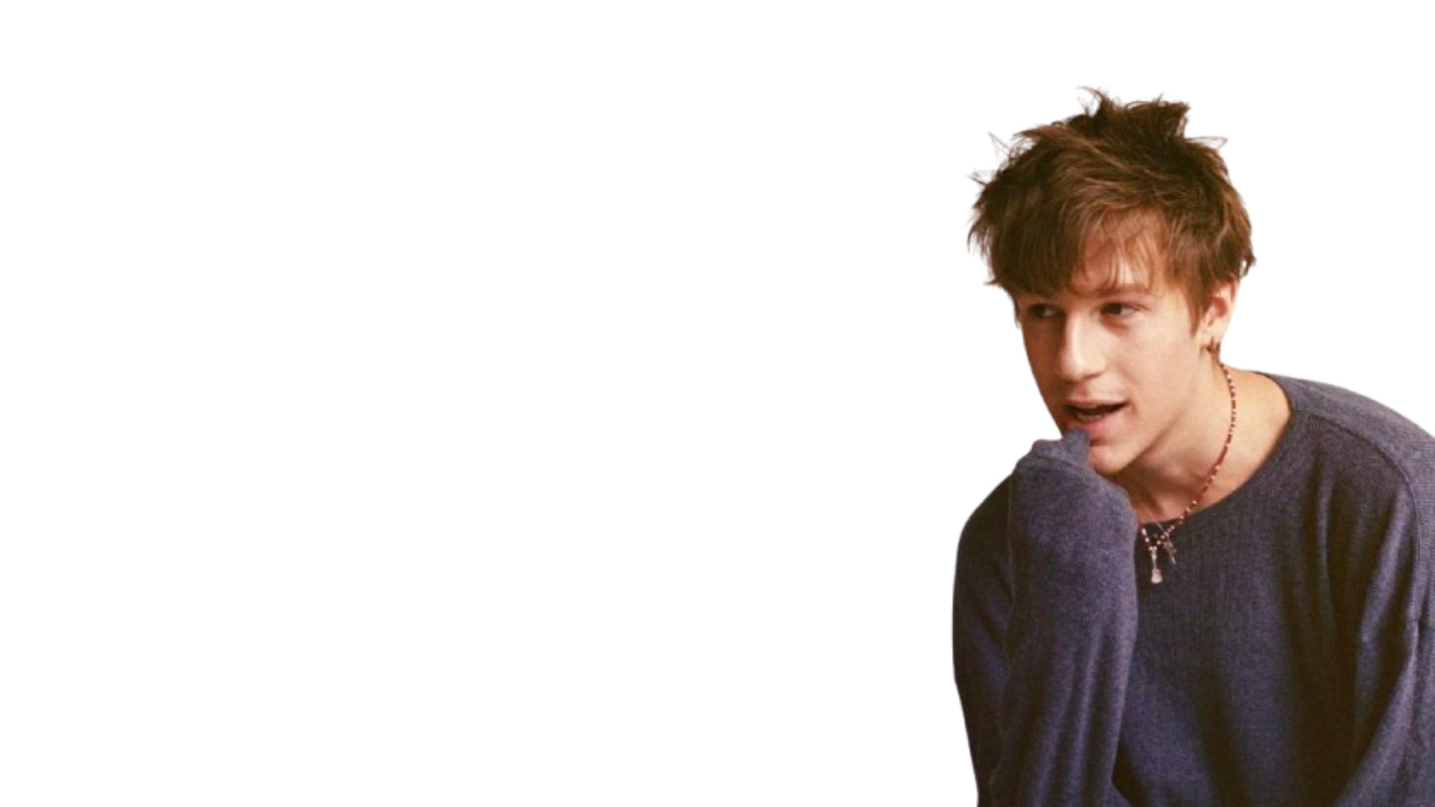
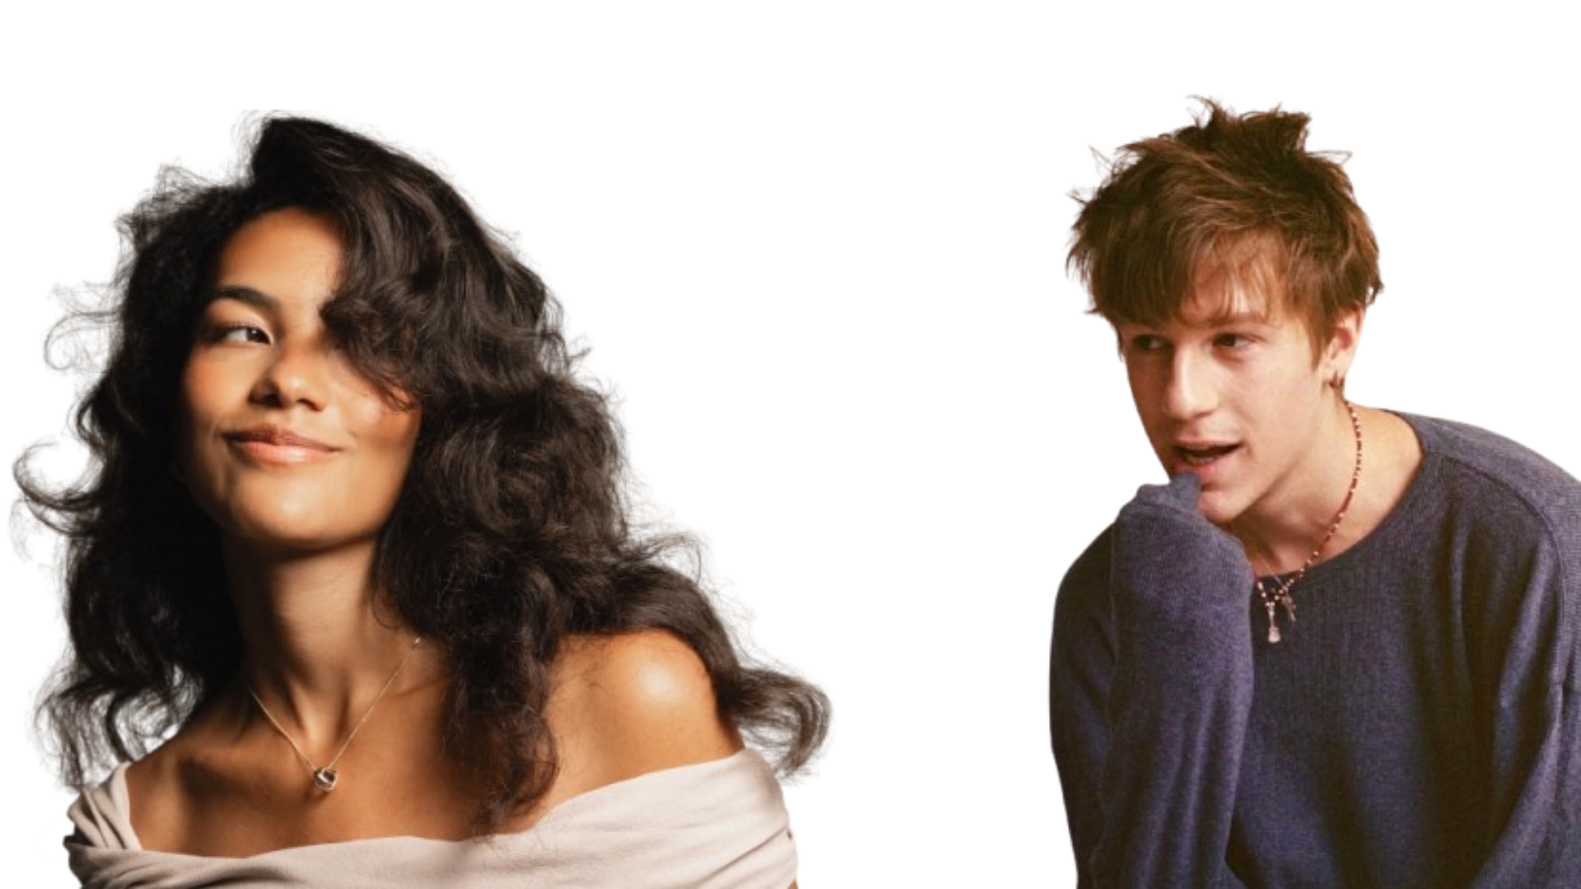
While there are many artists, majority
of this target audience listens music made by Malcom Todd and Olivia Dean.
Noteable Artists…
Notes:
Design Choices:
I focused on visual hierarchy by using a collage layout rather than a standard text-heavy format. I layered a custom text box directly over the artist imagery to provide context for 'Malcolm Todd' and 'Olivia Dean.’
Photo Credits : Google

Slide 7
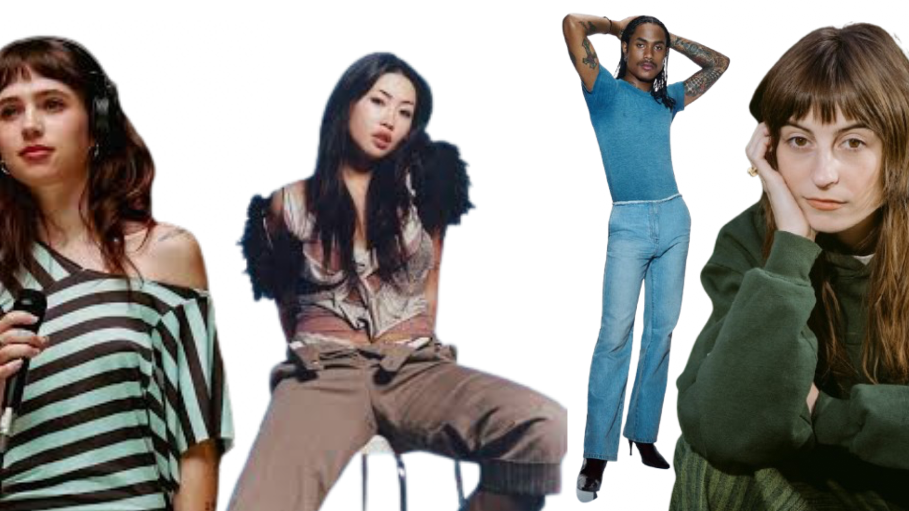
Faye Webster
beabadoobee
Clario
Other mentionable artists :
Steve Lacy
Notes:
Design Choices:
I manually placed the artist names into separate text boxes with varied alignments. This creates a more dynamic, "collage" style layout that mirrors the creative nature of the artists.
Photo Credits : Google

Slide 8
As of early 2016 – the
genre has accumulated 50-100 million monthly listeners.
Notes:
Design Choices:
I layered a semi-transparent call-out box over the graphic to highlight the '100 million monthly listeners' milestone. This ensures the data is the focal point while maintaining the deck's aesthetic consistency. Additionally, I manually positioned text elements to ensure a clean, professional finish.
Photo Credits : Google

Slide 9

Today’s Audience :
Ranging from young adults under the age of 21 who are located in major cities. These individuals engage with the sub-category as a method of
Decompression.
Notes:
Design Choices:
I incorporated an Action Button (linked to Slide 10) to facilitate non-linear navigation. This allows a live presenter to jump to supplemental information about 'Overlapping Genres' only if requested by the audience.
Photo Credits : Google

Slide 10

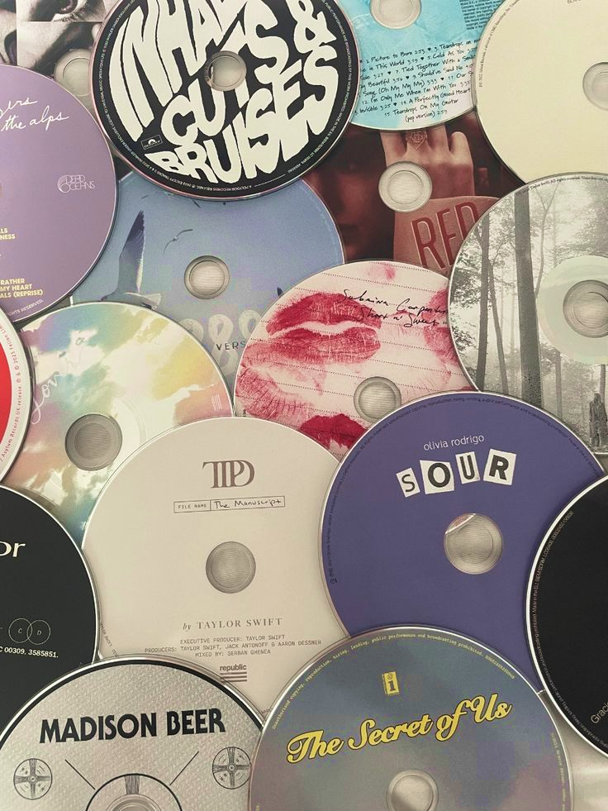
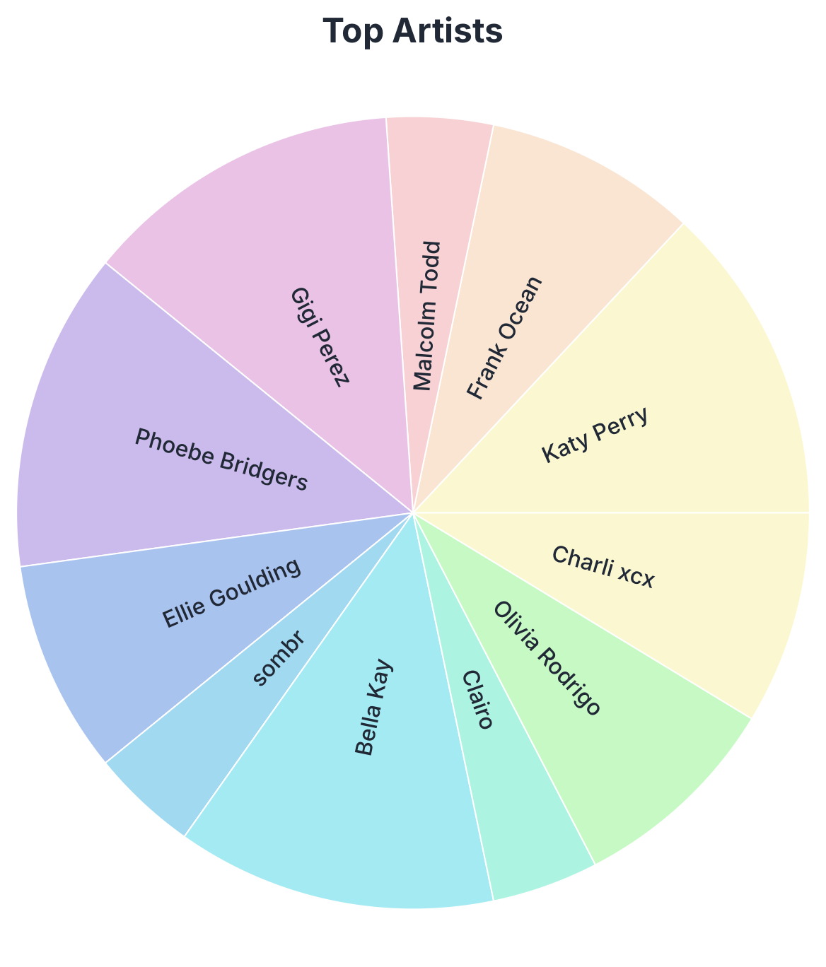
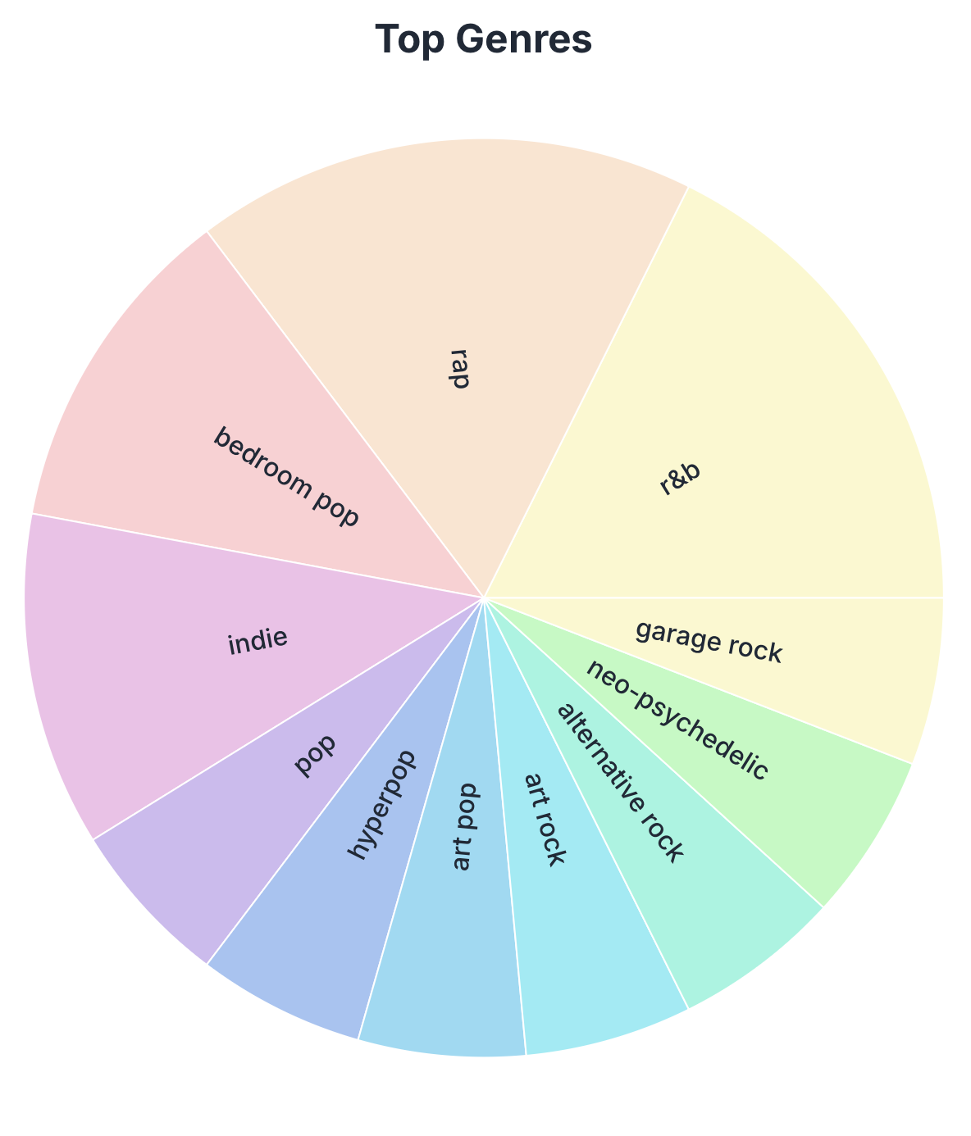
My personalized pie chart, featuring my most listened genres and artists via Trackify.am
Other overlapping genres of music include :
Indie, Adult, contemporary, R&B, Folklore, Psychedelic Funk, Soul
Return to the main menu.
Return to the main menu.
Notes:
Design Choices:
This is the Hidden Slide and is intentionally omitted from the main self-running sequence to ensure the primary narrative remains concise. I have configured this slide with a 'Return' hyperlink that brings the presenter back to the previous slide (Slide 9).
Photo Credits : Trackify

Slide 11


Interested ?
View Spotify’s
Soft-Pop Hits :
Click to view playlist
Notes:
Design Choices:
I integrated a functional hyperlink to a curated Spotify playlist, allowing the viewer to engage with the topic beyond the presentation environment..
Photo Credits : Google

Slide 12

Photo Credits:
Thank you for watching my presentation
All photos are from Google Images
Notes:
Design notes :
I used fade animations for a smooth, professional look and I utilized the same background to maintain consistency.

